Slide 1
College : Aditya Enginnering College
Speaker 1 : Takudzwa Lloyd Chimwa
Speaker 2 : Tafadzwa Mhere
Branch : Petroleum Technology

Slide 2

Title: "Digitalization in Petroleum Engineering: Transforming the Industry"
"Unleashing the Power of Digital Magic in Oil & Gas"

Slide 3
Introduction
"How can the petroleum industry thrive in an era of rapid change?"
"Through the strategic adoption of digitalization, the petroleum industry can not only thrive but also lead the way in achieving operational excellence, sustainability, and growth in a rapidly changing global landscape."
The petroleum industry is facing unprecedented challenges, including the transition to cleaner energy sources, stricter environmental regulations, and the need to optimize operations. Digitalization offers a transformative solution by harnessing the power of advanced technologies like Artificial Intelligence (AI), the Internet of Things (IoT), and Big Data Analytics.
By leveraging these digital tools, companies can enhance their operational efficiency, reduce costs, and make data-driven decisions. They can also minimize their environmental footprint by optimizing resource usage and reducing emissions, contributing to sustainability goals.
Moreover, digitalization allows the industry to adapt and innovate in real-time, staying competitive in an ever-evolving market. It empowers petroleum engineers and professionals to harness the full potential of data and technology, enabling them to navigate the complex challenges of the modern energy landscape.

Slide 4
What is Digitalization?
Digitalization is the strategic integration of cutting-edge digital technologies into every facet of petroleum engineering. It transforms traditional processes by harnessing the power of data, automation, and connectivity, enabling the industry to adapt, thrive, and excel in a rapidly evolving energy landscape."
Reference: "The Digital Oilfield: A Roadmap to Data-Driven Oil & Gas Operations" (2022, Society of Petroleum Engineers).

Slide 5
Key Digital Technologies
"Digitalization in petroleum engineering leverages several transformative technologies that are reshaping the industry. Here are the key players:
IoT (Internet of Things): IoT involves connecting devices and sensors across the oilfield to collect real-time data on equipment performance, environmental conditions, and more. This data informs decisions and enhances operational efficiency.
2. Big Data Analytics: Big Data Analytics processes and analyzes vast volumes of data generated by sensors and systems. It uncovers patterns, trends, and insights that empower informed decision-making and predictive maintenance.

Slide 6
Key Digital Technologies
3. Artificial Intelligence (AI) and Machine Learning: AI and ML algorithms analyze data to identify optimization opportunities in drilling, reservoir management, and production. They enable automation and enhance decision support systems.
4. Cloud Computing: Cloud solutions provide scalable and cost-effective storage and processing for immense datasets. They facilitate collaboration and accessibility of data from anywhere, promoting efficiency.

Slide 7
Key Digital Technologies
5. Digital Twins: Digital twins create virtual replicas of physical assets, such as oil rigs or pipelines. They allow real-time monitoring, simulation, and predictive maintenance, optimizing asset performance.
6. Blockchain: Blockchain technology enhances transparency, security, and traceability in supply chains and transactions within the petroleum industry, reducing fraud and ensuring compliance."
Reference: "Digital Transformation in Oil and Gas" (2021, Deloitte).

Slide 8
Cloud Computing
Scalability: The cloud allows the industry to scale its data storage and processing capabilities as needed, accommodating the immense volumes of data generated in exploration, production, and operations.
Cost-Efficiency: By eliminating the need for extensive on-premises infrastructure, cloud solutions reduce capital expenditure. Companies pay for the resources they use, making it a cost-efficient choice.

Slide 9
Cybersecurity
"Cybersecurity is paramount in digitalization efforts within petroleum engineering. It safeguards critical data and systems from cyber threats, ensuring the industry's operational integrity and data protection."

Slide 10
Environmental Impact
"Digitalization in petroleum engineering plays a pivotal role in mitigating the industry's environmental footprint. It achieves this through measures like reducing carbon emissions, optimizing resource usage, and actively contributing to sustainability goals."
Reference: "Digital Technologies for a Sustainable Energy Future" (2020, World Economic Forum).

Slide 11
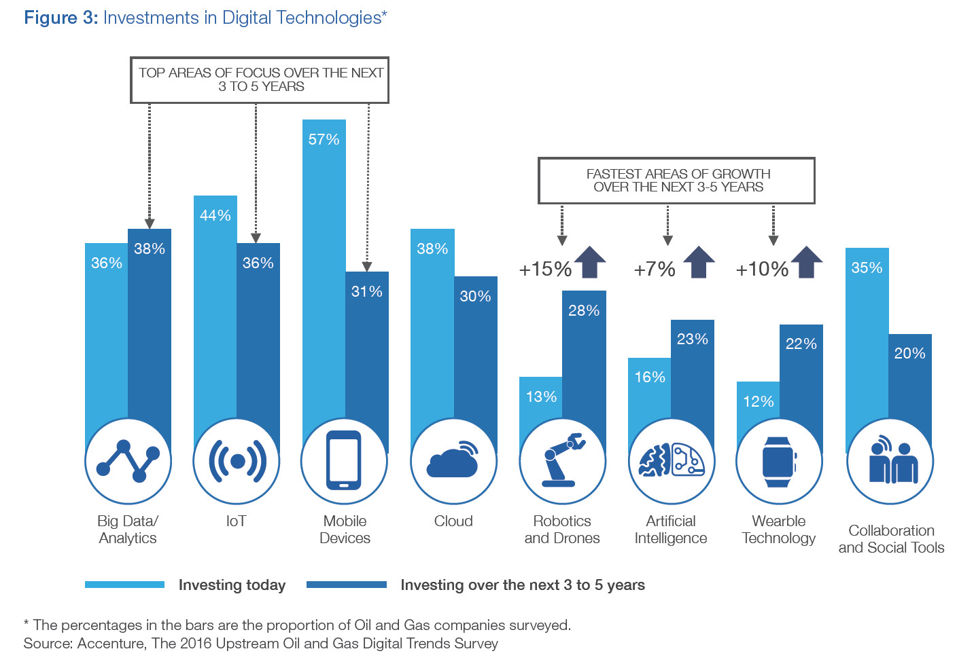
Case Studies

Slide 12
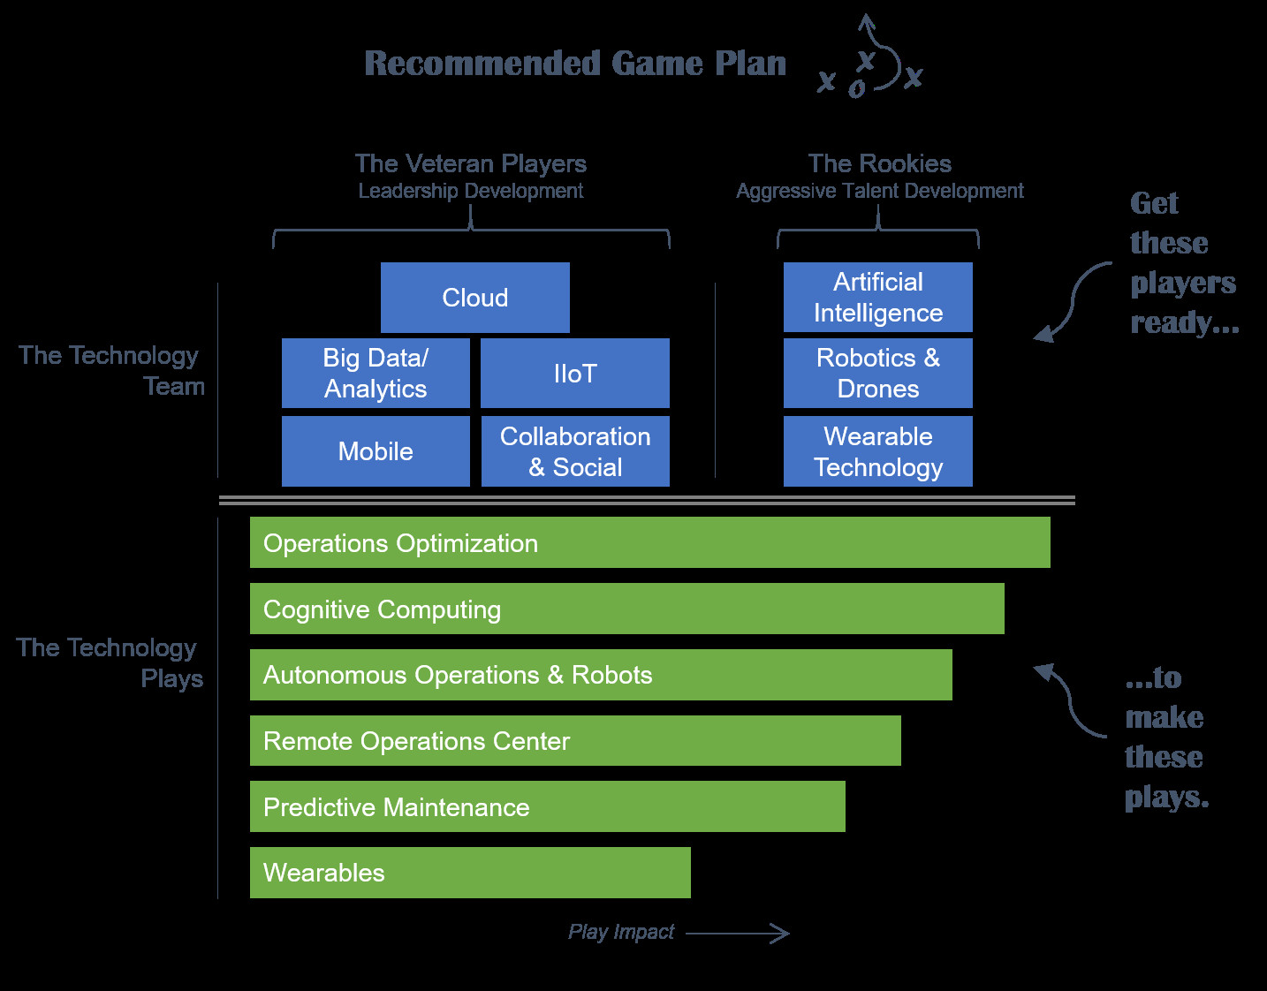
Case Study 2

Slide 13
Conclusion
"In conclusion, digitalization is not just a technological advancement; it's a transformative force reshaping petroleum engineering. Through the integration of cutting-edge technologies like AI, IoT, and Big Data Analytics, the industry is poised to achieve new heights of efficiency, sustainability, and adaptability.
With a focus on reducing carbon emissions, optimizing resource utilization, and enhancing environmental compliance, digitalization is at the forefront of addressing critical environmental challenges.

Slide 14
Maita Basa! Dhan'yavādālu!
Thank You!

